Slide 1
OPER 618 Lesson 03 Strategies in Normal Form Games
Dr. Brian J. Lunday
Office: Rm 201E, Bldg 641

Slide 2
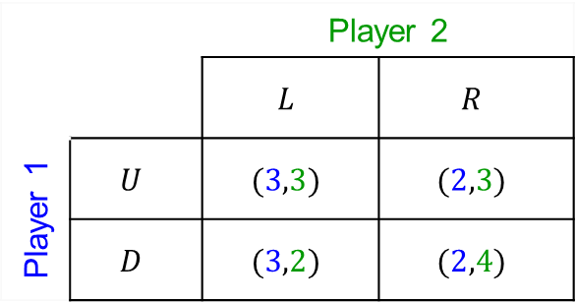
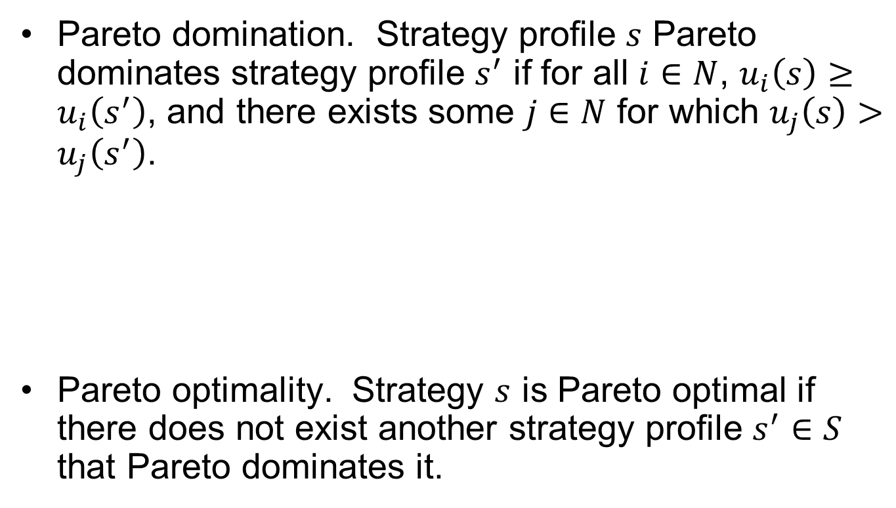
Pareto Optimality
Pareto domination. Strategy profile $s$ Pareto dominates strategy profile $s^{′}$ if for all $i∈N$, $u_{i}\left(s\right)≥u_{i}\left(s^{′}\right)$, and there exists some $j∈N$ for which $u_{j}\left(s\right)>u_{j}\left(s^{′}\right)$.
Pareto optimality. Strategy $s$ is Pareto optimal if there does not exist another strategy profile $s^{′}∈S$ that Pareto dominates it.
 |  | Player 2
 |  | $$L$$ | $$R$$
Player 1 | $$U$$ | $$(3,3)$$ | $$(2,3)$$
 | $$D$$ | $$(3,2)$$ | $$(2,4)$$

Slide 3
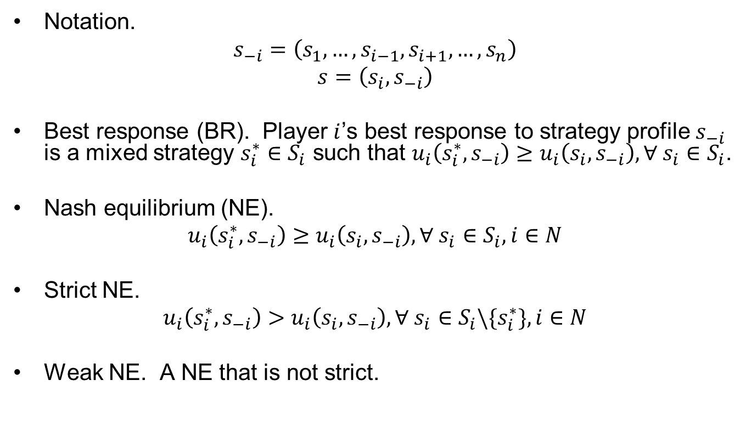
Nash Equilibria
Notation.
$$s_{−i}=\left(s_{1},…,s_{i−1},s_{i+1},…,s_{n}\right)$$
$$s=\left(s_{i},s_{−i}\right)$$
Best response (BR). Player $i$’s best response to strategy profile $s_{−i}$ is a mixed strategy $s_{i}^{∗}∈S_{i}$ such that $u_{i}\left(s_{i}^{∗},s_{−i}\right)≥u_{i}\left(s_{i},s_{−i}\right), ∀ s_{i}∈S_{i}$.
Nash equilibrium (NE).
$$u_{i}\left(s_{i}^{∗},s_{−i}\right)≥u_{i}\left(s_{i},s_{−i}\right), ∀ s_{i}∈S_{i}, i∈N$$
Strict NE.
$$u_{i}\left(s_{i}^{∗},s_{−i}\right)>u_{i}\left(s_{i},s_{−i}\right), ∀ s_{i}∈S_{i}\backslash \{s_{i}^{∗}\}, i∈N$$
Weak NE. A NE that is not strict.

Slide 4
Classic Games

Slide 5
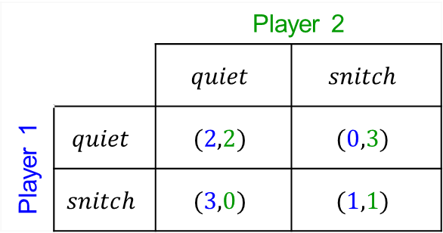

Classic Game #1 Prisoner’s Dilemma (PD)
A finite two-player, normal form, zero-sum symmetric game with complete information.
$N=\{1,2\}$.
$A_{1}=A_{2}=\left\{snitch,stay quiet\right\}$
Symmetric utilities for the two players. For example…
$$u_{1}\left(snitch,quiet\right)>u_{1}(quiet,quiet)>u_{1}(snitch,snitch)>u_{1}(quiet,snitch)$$
What can you make of this game?
 |  | Player 2
 |  | $$quiet$$ | $$snitch$$
Player 1 | $$quiet$$ | $$(2,2)$$ | $$(0,3)$$
 | $$snitch$$ | $$(3,0)$$ | $$(1,1)$$

Slide 6
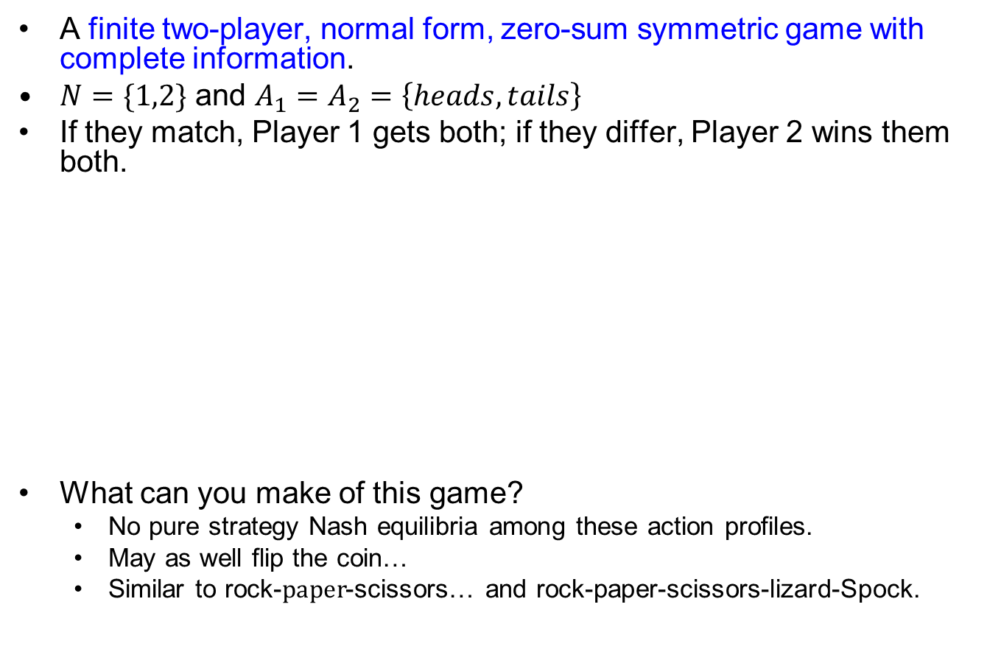
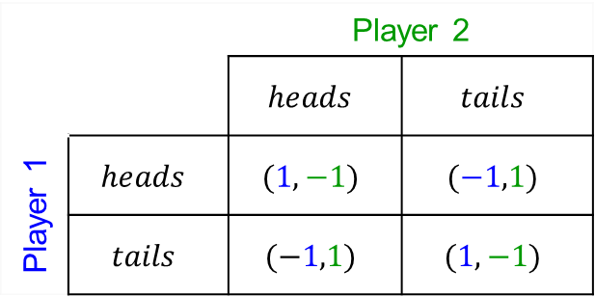
Classic Game #4 Matching Pennies (MP)
A finite two-player, normal form, zero-sum symmetric game with complete information.
$N=\{1,2\}$ and $A_{1}=A_{2}=\left\{heads,tails\right\}$
If they match, Player 1 gets both; if they differ, Player 2 wins them both.
What can you make of this game?
No pure strategy Nash equilibria among these action profiles.
May as well flip the coin…
Similar to rock-paper-scissors… and rock-paper-scissors-lizard-Spock.
 |  | Player 2
 |  | $$heads$$ | $$tails$$
Player 1 | $$heads$$ | $$(1,−1)$$ | $$(−1,1)$$
 | $$tails$$ | $$(−1,1)$$ | $$(1,−1)$$

Slide 7
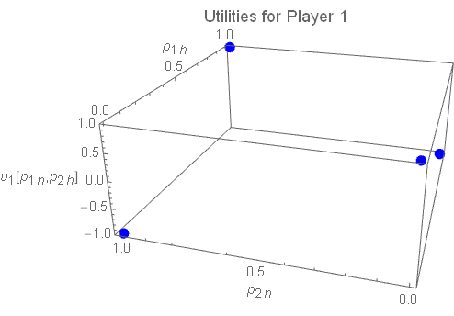
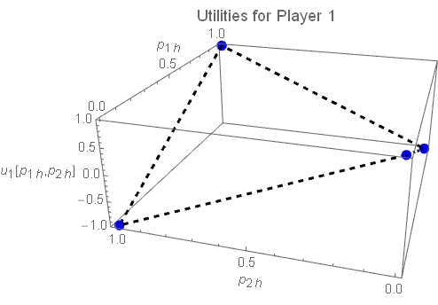
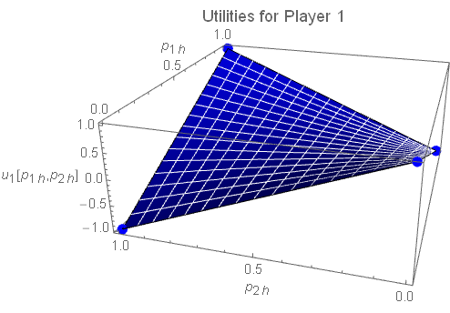

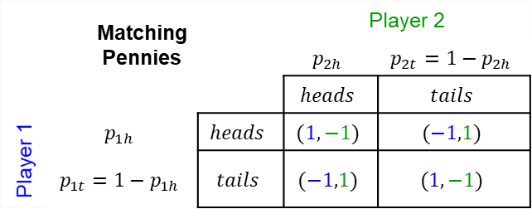


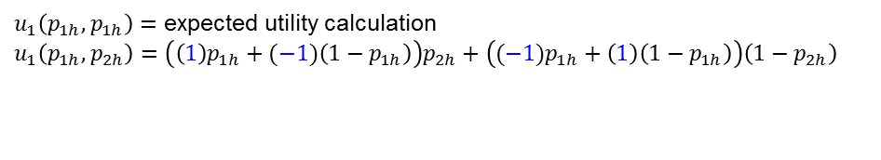
MP: Player 1’s Utility Under Mixed Strategies
Matching Pennies |  |  | Player 2
 |  |  | $$p_{2h}$$ | $$p_{2t}=1−p_{2h}$$
 |  |  | $$heads$$ | $$tails$$
Player 1 | $$p_{1h}$$ | $$heads$$ | $$(1,−1)$$ | $$(−1,1)$$
 | $$p_{1t}=1−p_{1h}$$ | $$tails$$ | $$(−1,1)$$ | $$(1,−1)$$
$u_{1}\left(p_{1h},p_{1h}\right)=$ expected utility calculation
$$u_{1}\left(p_{1h},p_{2h}\right)=\left(\left(1\right)p_{1h}+(−1)\left(1−p_{1h}\right)\right)p_{2h}+\left((−1)p_{1h}+\left(1\right)\left(1−p_{1h}\right)\right)\left(1−p_{2h}\right)$$
weighted combination
of $p_{1h}$ and $p_{1t}$ when $p_{2h}=1$
weighted combination
of $p_{1h}$ and $p_{1t}$ when $p_{2h}=0$
weighted combination of $p_{2h}$ and $p_{2t}$
Which equals $u_{1}\left(p_{1h},p_{2h}\right)=1−2p_{1h}−2p_{2h}+4p_{1h}p_{2h}$

Slide 8
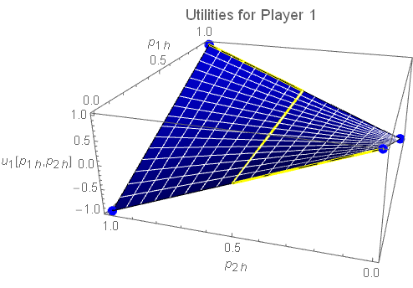
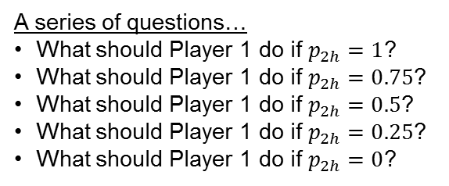
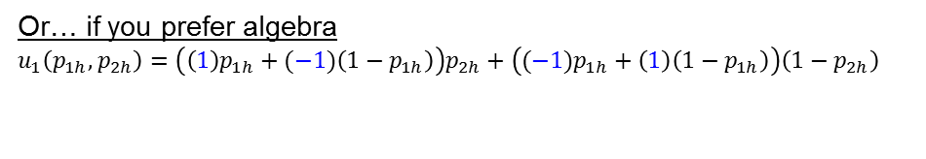
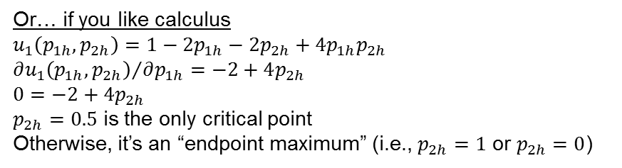
MP: Player 1’s Best Response Under Mixed Strategies
Matching Pennies |  |  | Player 2
 |  |  | $$p_{2h}$$ | $$p_{2t}=1−p_{2h}$$
 |  |  | $$heads$$ | $$tails$$
Player 1 | $$p_{1h}$$ | $$heads$$ | $$(1,−1)$$ | $$(−1,1)$$
 | $$p_{1t}=1−p_{1h}$$ | $$tails$$ | $$(−1,1)$$ | $$(1,−1)$$
A series of questions…
What should Player 1 do if $p_{2h}=1$?
What should Player 1 do if $p_{2h}=0.75$?
What should Player 1 do if $p_{2h}=0.5$?
What should Player 1 do if $p_{2h}=0.25$?
What should Player 1 do if $p_{2h}=0$?
Or… if you prefer algebra
$$u_{1}\left(p_{1h},p_{2h}\right)=\left(\left(1\right)p_{1h}+(−1)\left(1−p_{1h}\right)\right)p_{2h}+\left((−1)p_{1h}+\left(1\right)\left(1−p_{1h}\right)\right)\left(1−p_{2h}\right)$$
Is there a value for $p_{2h}$ that makes these terms equal?
Or… if you like calculus
$$u_{1}\left(p_{1h},p_{2h}\right)=1−2p_{1h}−2p_{2h}+4p_{1h}p_{2h}$$
$${∂u_{1}\left(p_{1h},p_{2h}\right)}/{∂p_{1h}}=−2+4p_{2h}$$
$$0=−2+4p_{2h}$$
$p_{2h}=0.5$ is the only critical point
Otherwise, it’s an “endpoint maximum” (i.e., $p_{2h}=1$ or $p_{2h}=0$)

Slide 9
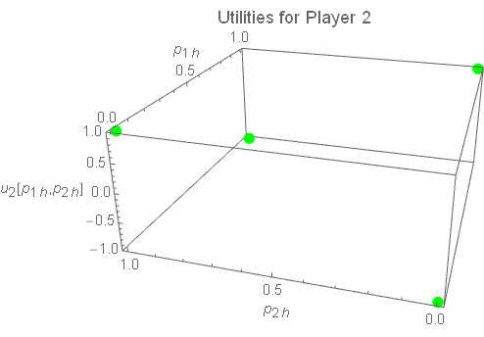
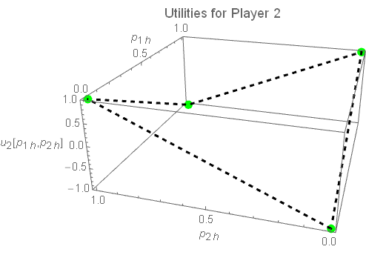
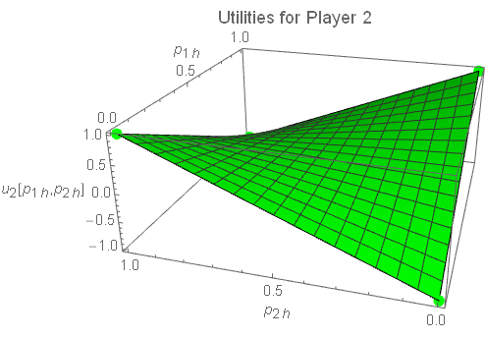


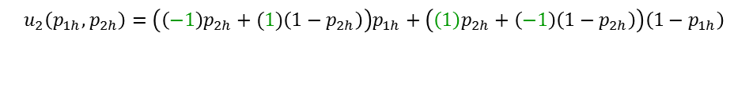

MP: Player 2’s Utility Under Mixed Strategies
Matching Pennies |  |  | Player 2
 |  |  | $$p_{2h}$$ | $$p_{2t}=1−p_{2h}$$
 |  |  | $$heads$$ | $$tails$$
Player 1 | $$p_{1h}$$ | $$heads$$ | $$(1,−1)$$ | $$(−1,1)$$
 | $$p_{1t}=1−p_{1h}$$ | $$tails$$ | $$(−1,1)$$ | $$(1,−1)$$
$$u_{2}\left(p_{1h},p_{2h}\right)=\left(\left(−1\right)p_{2h}+(1)\left(1−p_{2h}\right)\right)p_{1h}+\left(\left(1\right)p_{2h}+\left(−1\right)\left(1−p_{2h}\right)\right)\left(1−p_{1h}\right)$$
weighted combination
of $p_{2h}$ and $p_{2t}$when$p_{1h}=1$
weighted combination
of $p_{2h}$ and $p_{2t}$when${ p}_{1h}=0$
weighted combination of$p_{1h}$ and $p_{1t}$
Which equals $u_{2}\left(p_{1h},p_{2h}\right)=−1+2p_{1h}+2p_{2h}−4p_{1h}p_{2h}$

Slide 10

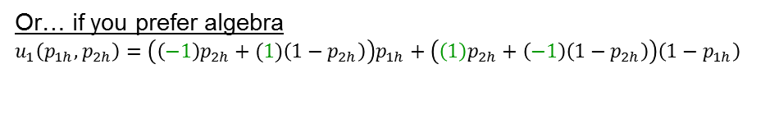
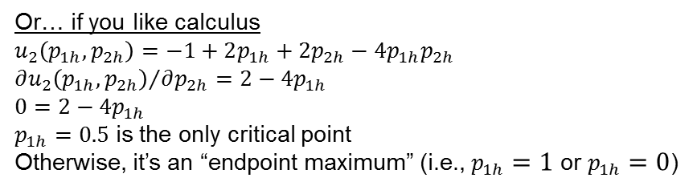
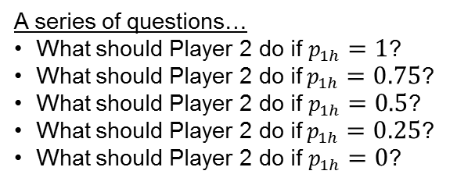
MP: Player 2’s Best Response Under Mixed Strategies
Matching Pennies |  |  | Player 2
 |  |  | $$p_{2h}$$ | $$p_{2t}=1−p_{2h}$$
 |  |  | $$heads$$ | $$tails$$
Player 1 | $$p_{1h}$$ | $$heads$$ | $$(1,−1)$$ | $$(−1,1)$$
 | $$p_{1t}=1−p_{1h}$$ | $$tails$$ | $$(−1,1)$$ | $$(1,−1)$$
A series of questions…
What should Player 2 do if $p_{1h}=1$?
What should Player 2 do if$p_{1h}=0.75$?
What should Player 2 do if $p_{1h}=0.5$?
What should Player 2 do if$p_{1h}=0.25$?
What should Player 2 do if $p_{1h}=0$?
Or… if you prefer algebra
$$u_{1}\left(p_{1h},p_{2h}\right)=\left(\left(−1\right)p_{2h}+(1)\left(1−p_{2h}\right)\right)p_{1h}+\left(\left(1\right)p_{2h}+\left(−1\right)\left(1−p_{2h}\right)\right)\left(1−p_{1h}\right)$$
Is there a value for $p_{1h}$ that makes these terms equal?
Or… if you like calculus
$$u_{2}\left(p_{1h},p_{2h}\right)=−1+2p_{1h}+2p_{2h}−4p_{1h}p_{2h}$$
$${∂u_{2}\left(p_{1h},p_{2h}\right)}/{∂p_{2h}}=2−4p_{1h}$$
$$0=2−4p_{1h}$$
$p_{1h}=0.5$ is the only critical point
Otherwise, it’s an “endpoint maximum” (i.e., $p_{1h}=1$ or $p_{1h}=0$)

Slide 11
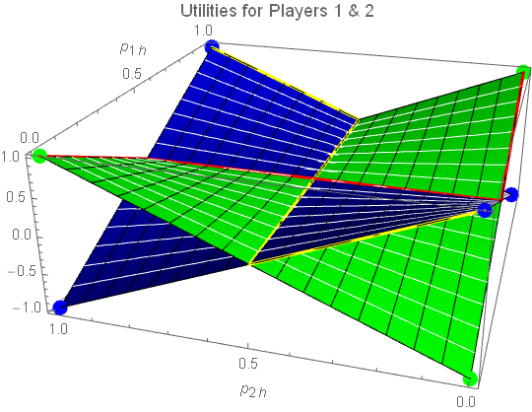


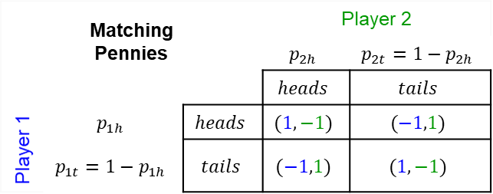

MP: Players’ Mutual Best Responses (i.e., Nash Equilibria)
Matching Pennies |  |  | Player 2
 |  |  | $$p_{2h}$$ | $$p_{2t}=1−p_{2h}$$
 |  |  | $$heads$$ | $$tails$$
Player 1 | $$p_{1h}$$ | $$heads$$ | $$(1,−1)$$ | $$(−1,1)$$
 | $$p_{1t}=1−p_{1h}$$ | $$tails$$ | $$(−1,1)$$ | $$(1,−1)$$
For mixed strategy games, a Nash equilibrium is a strategy profile from which no player can unilaterally change strategy and improve their utility.
$$p_{1h}$$
1
0.5
$$p_{2h}$$
0
1
0.5
0
So $\left(p_{1h},p_{2h}\right)=(0.5,0.5)$ is a mixed-strategy Nash equilibrium.
What does that mean?
What’s the value in identifying this?
Formally, the NE is
$$s=\left(s_{1},s_{2}\right)=\left(\left[\begin{matrix}0.5 \\ 0.5\end{matrix}\right],\left[\begin{matrix}0.5 \\ 0.5\end{matrix}\right]\right)$$

Slide 12
What’s so interesting here?
Every normal form game has a Nash equilibrium when mixed strategies are allowed.
This helps gain insight for…
A competition that recurs.
A random distribution to use when no single action dominates the others.
What do you expect the mixed-strategy Nash equilibrium is for Rock-Paper-Scissors-Lizard-Spock?

Slide 13
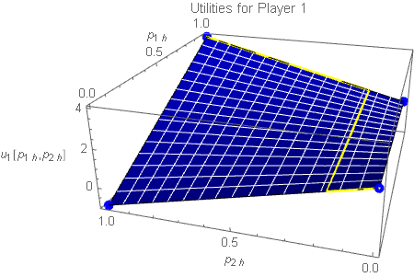
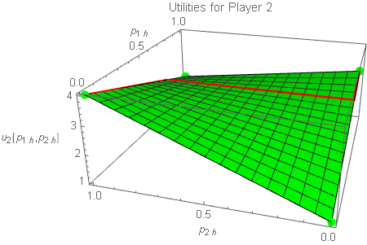
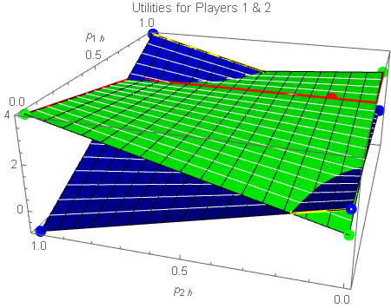



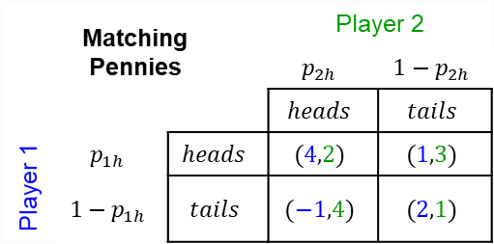
Players’ Mutual Best Responses (No Pure Nash Equilibria; asymmetric game)
Matching Pennies |  |  | Player 2
 |  |  | $$p_{2h}$$ | $$1−p_{2h}$$
 |  |  | $$heads$$ | $$tails$$
Player 1 | $$p_{1h}$$ | $$heads$$ | $$(4,2)$$ | $$(1,3)$$
 | $$1−p_{1h}$$ | $$tails$$ | $$(−1,4)$$ | $$(2,1)$$
$$s=\left(s_{1},s_{2}\right)=\left(\left[\begin{matrix}0.75 \\ 0.25\end{matrix}\right],\left[\begin{matrix}0.1\overline{6} \\ 0.8\overline{3}\end{matrix}\right]\right)$$
$$p_{1h}$$
1
0.5
$$p_{2h}$$
0
1
0.5
0
Here, $\left(p_{1h},p_{2h}\right)=(0.75,0.1\overline{6})$ is a mixed-strategy Nash equilibrium.
What do you expect to happen if both players are rational and understand the game? Why?

Slide 14
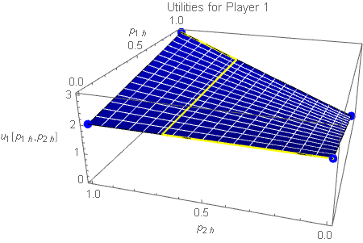
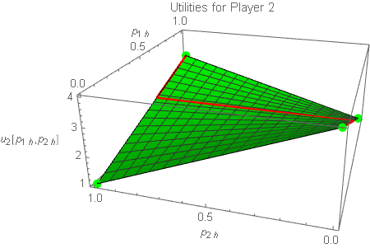
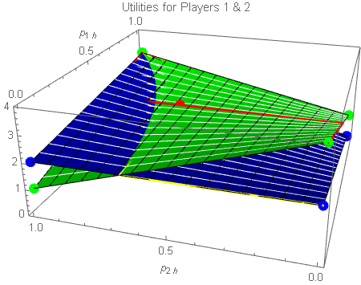
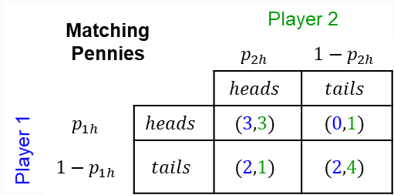

Players’ Mutual Best Responses (2 Pure Nash Equilibria; both Pareto Optimal; asymmetric game)
Matching Pennies |  |  | Player 2
 |  |  | $$p_{2h}$$ | $$1−p_{2h}$$
 |  |  | $$heads$$ | $$tails$$
Player 1 | $$p_{1h}$$ | $$heads$$ | $$(3,3)$$ | $$(0,1)$$
 | $$1−p_{1h}$$ | $$tails$$ | $$(2,1)$$ | $$(2,4)$$
$$s=\left(s_{1},s_{2}\right)=\left\{\left(\left[\begin{matrix}1 \\ 0\end{matrix}\right],\left[\begin{matrix}1 \\ 0\end{matrix}\right]\right),\left(\left[\begin{matrix}0.6 \\ 0.4\end{matrix}\right],\left[\begin{matrix}0.6\overline{6} \\ 0.3\overline{3}\end{matrix}\right]\right),\left(\left[\begin{matrix}0 \\ 1\end{matrix}\right],\left[\begin{matrix}0 \\ 1\end{matrix}\right]\right)\right\}$$
$$p_{1h}$$
1
0.5
$$p_{2h}$$
0
1
0.5
0
Here, $\left(p_{1h},p_{2h}\right)=(0.6,0.6\overline{6})$ is a mixed-strategy Nash equilibrium.
What do you expect to happen if both players are rational and understand the game? Why?

Slide 15
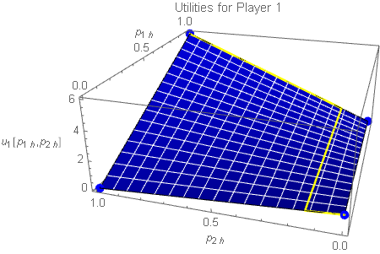
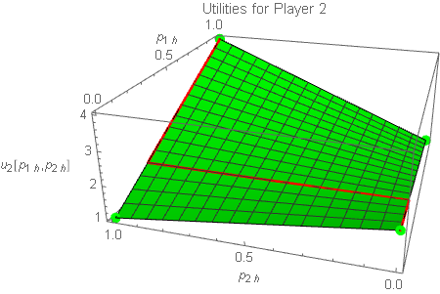
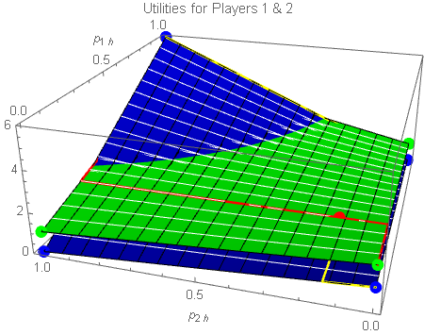

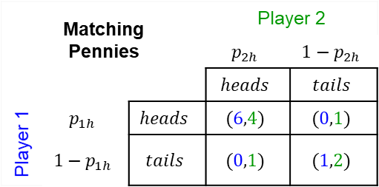
Players’ Mutual Best Responses (2 Pure Nash Equilibria; one preferable; asymmetric game)
Matching Pennies |  |  | Player 2
 |  |  | $$p_{2h}$$ | $$1−p_{2h}$$
 |  |  | $$heads$$ | $$tails$$
Player 1 | $$p_{1h}$$ | $$heads$$ | $$(6,4)$$ | $$(0,1)$$
 | $$1−p_{1h}$$ | $$tails$$ | $$(0,1)$$ | $$(1,2)$$
$$s=\left(s_{1},s_{2}\right)=\left\{\left(\left[\begin{matrix}1 \\ 0\end{matrix}\right],\left[\begin{matrix}1 \\ 0\end{matrix}\right]\right),\left(\left[\begin{matrix}0.25 \\ 0.75\end{matrix}\right],\left[\begin{matrix}0.143 \\ 0.857\end{matrix}\right]\right),\left(\left[\begin{matrix}0 \\ 1\end{matrix}\right],\left[\begin{matrix}0 \\ 1\end{matrix}\right]\right)\right\}$$
$$p_{1h}$$
1
0.5
$$p_{2h}$$
0
1
0.5
0
Here, $\left(p_{1h},p_{2h}\right)=(0.25,0.143)$ is a mixed-strategy Nash equilibrium.
What do you expect to happen if both players are rational and understand the game? Why?

Slide 16
Discussion Questions
How can you tell if your opponent is playing a mixed strategy?
Should you play a mixed strategy?
For what applications is a mixed strategy feasible?
For what applications is a mixed strategy worthless?
What alternatives are there?

Slide 17

Classic Game #2 Coordination Game
A finite two-player, normal form, zero-sum symmetric game with complete information.
$N=\{1,2\}$ and $A_{1}=A_{2}=\left\{walk dog, run\right\}$ actions to take on a Saturday morning.
Symmetric utilities for the two players.
What are the mixed strategy Nash equilibria?
 |  | Player 2
 |  | $$walk$$ | $$run$$
Player 1 | $$walk$$ | $$\left(5,5\right)$$ | $$(0,0)$$
 | $$run$$ | $$(0,0)$$ | $$\left(8,8\right)$$

Slide 18
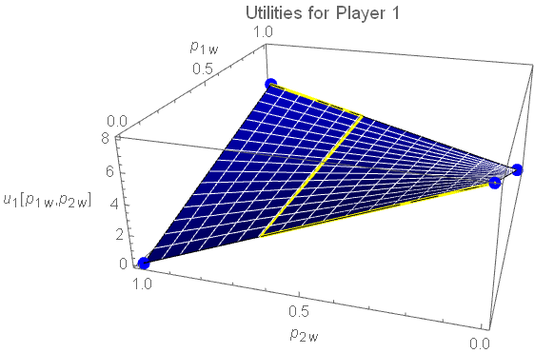
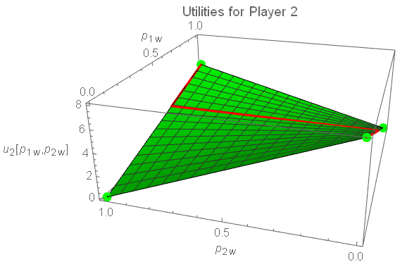
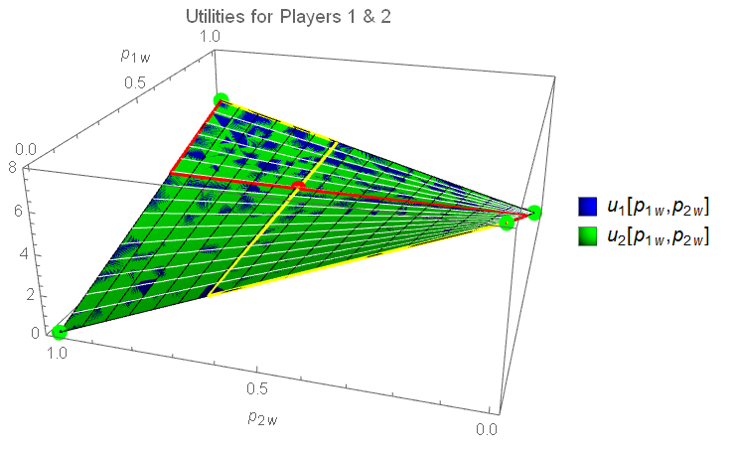
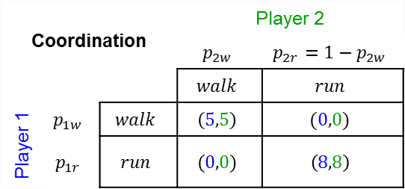

Classic Game #2 Coordination Game
Coordination |  |  | Player 2
 |  |  | $$p_{2w}$$ | $$p_{2r}=1−p_{2w}$$
 |  |  | $$walk$$ | $$run$$
Player 1 | $$p_{1w}$$ | $$walk$$ | $$\left(5,5\right)$$ | $$(0,0)$$
 | $$p_{1r}$$ | $$run$$ | $$(0,0)$$ | $$\left(8,8\right)$$
$$s=\left(s_{1},s_{2}\right)=\left\{\left(\left[\begin{matrix}1 \\ 0\end{matrix}\right],\left[\begin{matrix}1 \\ 0\end{matrix}\right]\right),\left(\left[\begin{matrix}0.615 \\ 0.385\end{matrix}\right],\left[\begin{matrix}0.615 \\ 0.385\end{matrix}\right]\right),\left(\left[\begin{matrix}0 \\ 1\end{matrix}\right],\left[\begin{matrix}0 \\ 1\end{matrix}\right]\right)\right\}$$
$$p_{1h}$$
1
0.5
$$p_{2h}$$
0
1
0.5
0
Here, $\left(p_{1w},p_{2w}\right)=(0.615,0.615)$ is a mixed-strategy Nash equilibrium.
What do you expect to happen if both players are rational and understand the game? Why?

Slide 19
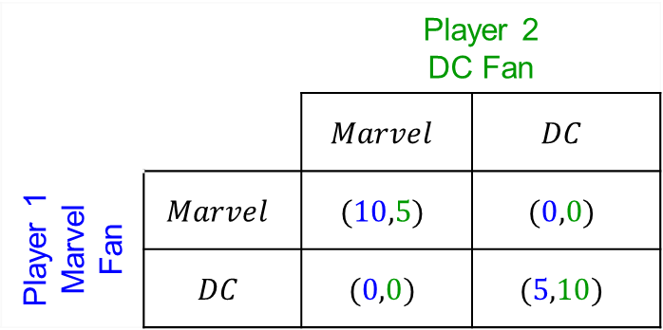

Classic Game #3 Battle of the Sexes (BoS)
A finite two-player, normal form, zero-sum symmetric game with complete information.
$N=\{1,2\}$ and $A_{1}=A_{2}=\left\{Marvel movie,DC movie\right\}$.
Asymmetric utilities for the two players who want to watch a superhero movie together.
What are the mixed strategy Nash equilibria?
 |  | Player 2 DC Fan
 |  | $$Marvel$$ | $$DC$$
Player 1 Marvel Fan | $$Marvel$$ | $$(10,5)$$ | $$(0,0)$$
 | $$DC$$ | $$(0,0)$$ | $$(5,10)$$

Slide 20
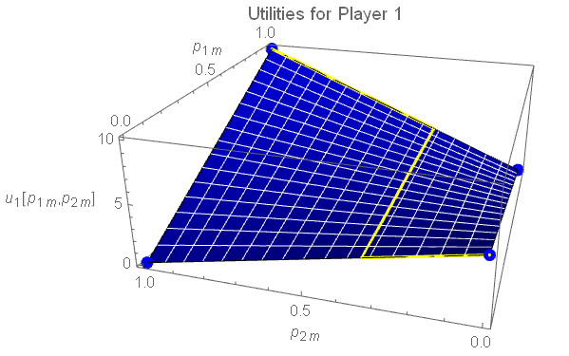
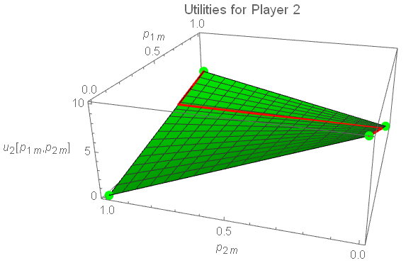
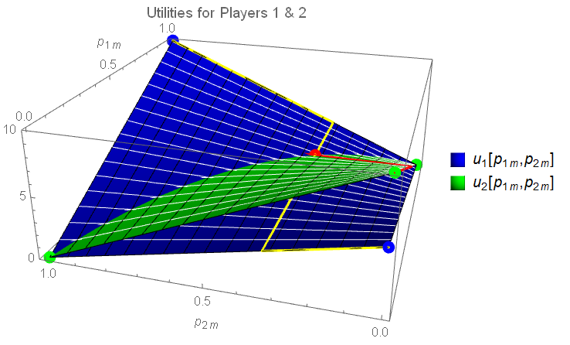
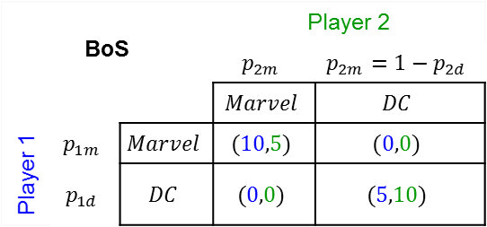

Classic Game #3 Battle of the Sexes (BoS)
BoS |  |  | Player 2
 |  |  | $$p_{2m}$$ | $$p_{2m}=1−p_{2d}$$
 |  |  | $$Marvel$$ | $$DC$$
Player 1 | $$p_{1m}$$ | $$Marvel$$ | $$(10,5)$$ | $$(0,0)$$
 | $$p_{1d}$$ | $$DC$$ | $$(0,0)$$ | $$(5,10)$$
$$s=\left(s_{1},s_{2}\right)=\left\{\left(\left[\begin{matrix}1 \\ 0\end{matrix}\right],\left[\begin{matrix}1 \\ 0\end{matrix}\right]\right),\left(\left[\begin{matrix}0.6\overline{6} \\ 0.3\overline{3}\end{matrix}\right],\left[\begin{matrix}0.3\overline{3} \\ 0.6\overline{6}\end{matrix}\right]\right),\left(\left[\begin{matrix}1 \\ 0\end{matrix}\right],\left[\begin{matrix}0 \\ 1\end{matrix}\right]\right)\right\}$$
$$p_{1h}$$
1
0.5
$$p_{2h}$$
0
1
0.5
0
Here, $\left(p_{1m},p_{2m}\right)=(2/3,1/3)$ is a mixed-strategy Nash equilibrium.
What do you expect to happen if both players are rational and understand the game? Why?

Slide 21
A Network-based Application
Consider a road network depicting paths from City 1 to City 7, with the time of travel indicated on each arc.
Your enemy will chose a path that has the shortest travel time.
You can monitor one arc in the shaded region with a UAV to detect the enemy during travel and attack him.
Due to operational restrictions, you can only target arcs in the shaded region.
Which arc should you target? (i.e., How often should you target each arc?)
Can also be viewed as “What percentage of my UAV fleet should I dedicate to each arc?”
Questions
What happens if you just go with the highest probability all the time?
How can you change the game, as the interdictor?
→ Change the utilities, make it incomplete (deceive regarding action space), be covert (traveler doesn’t know there’s a game)
Arc Inspection |  |  | Traveler
 |  |  | $$p=1/3$$ | $$p=1/3$$ | $$p=1/3$$
 |  |  | $$2→4$$ | $$2→5$$ | $$3→6$$
Hunter | $$p=0.38$$ | $$2→4$$ | $$(1, −1)$$ | $$(0,3)$$ | $$(0, 1)$$
 | $$p=0.54$$ | $$2→5$$ | $$(0, 2)$$ | $$(1,−1)$$ | $$(0, 1)$$
 | $$p=0.08$$ | $$3→6$$ | $$(0, 2)$$ | $$(0,3)$$ | $$(1,−1)$$
5
2
4
3
6
6
1
5
4
7
3
5
3
7
2
6
UAV Base
Traveler prefers shortest path that avoids the UAV
Hunter prefers success over failure

Slide 22
Existence of a Nash Equilibrium (Section 3.3.4 Structural Proof)
Theorem 3.3.2 (Nash, 1951) Every game with a finite number of players and actions profiles has at least one Nash Equilibrium
Definition 3.3.7 (Convexity)
Corollary 3.3.21 (Brouwer’s FP Theorem, simplotopes). Every continuous function $f:K↦K$ for a simplotope $K$ has a fixed point, $s$, $f\left(s\right)=s$
Corollary 3.3.21 (Brouwer’s FP Theorem, simplotopes). Every continuous function 𝑓:𝐾↦𝐾 for a simplotope 𝐾 has a fixed point, 𝑠, 𝑓(𝑠)=𝑠
Theorem 3.3.17 (Brouwer’s FP Theorem)
Definition 3.3.15 (Compactness)
Definition 3.3.19 (Homeomorphism)
Definition 3.3.20 (Interior)
Definition 3.3.18 (Bijective function)
Lemma 3.3.14 (Sperner’s lemma)
Definition 3.3.13 (Complete labeling)
Definition 3.3.10 (Standard n-simplex)
Definition 3.3.7 (Convexity)
Definition 3.3.7 (Convexity)
Definition 3.3.8 (Affine independence)
Definition 3.3.12 (Proper labeling)
Definition 3.3.11 (Simplicial subdivision)
Definition 3.3.9 (n-simplex)
Definition 3.3.16 (Centroid)
Definition 3.3.15 (Compactness)
Definition 3.3.7 (Convexity)
Equation (3.5) (Adjusted pmf on supports)
$$φ_{i,a_{i}}\left(s\right)=\max\left\{0,u_{i}\left(a_{i},s_{−i}\right)−u_{i}\left(s\right)\right\}$$
$$s_{i}^{′}\left(a_{i}\right)=\frac{s_{i}\left(a_{i}\right)+φ_{i,a_{i}}\left(s\right)}{\sum_{b_{i}∈A_{i}}{\left(s_{i}\left(b_{i}\right)+φ_{i,b_{i}}\left(s\right)\right)}}$$
$$s_{i}^{′}\left(a_{i}\right)=\frac{s_{i}\left(a_{i}\right)+φ_{i,a_{i}}\left(s\right)}{1+\sum_{b_{i}∈A_{i}}{φ_{i,b_{i}}\left(s\right)}}$$
Equation (3.5) (Adjusted pmf on supports)
𝜑_(𝑖,𝑎_𝑖 ) (𝑠)=max⁡{0,𝑢_𝑖 (𝑎_𝑖,𝑠_(−𝑖) )−𝑢_𝑖 (𝑠)}
𝑠_𝑖^′ (𝑎_𝑖 )=(𝑠_𝑖 (𝑎_𝑖 )+𝜑_(𝑖,𝑎_𝑖 ) (𝑠))/(∑_(𝑏_𝑖∈𝐴_𝑖)▒(𝑠_𝑖 (𝑏_𝑖 )+𝜑_(𝑖,𝑏_𝑖 ) (𝑠)) )
𝑠_𝑖^′ (𝑎_𝑖 )=(𝑠_𝑖 (𝑎_𝑖 )+𝜑_(𝑖,𝑎_𝑖 ) (𝑠))/(1+∑_(𝑏_𝑖∈𝐴_𝑖)▒〖𝜑_(𝑖,𝑏_𝑖 ) (𝑠) 〗)

Slide 23
Questions & Discussion

